Slide 1
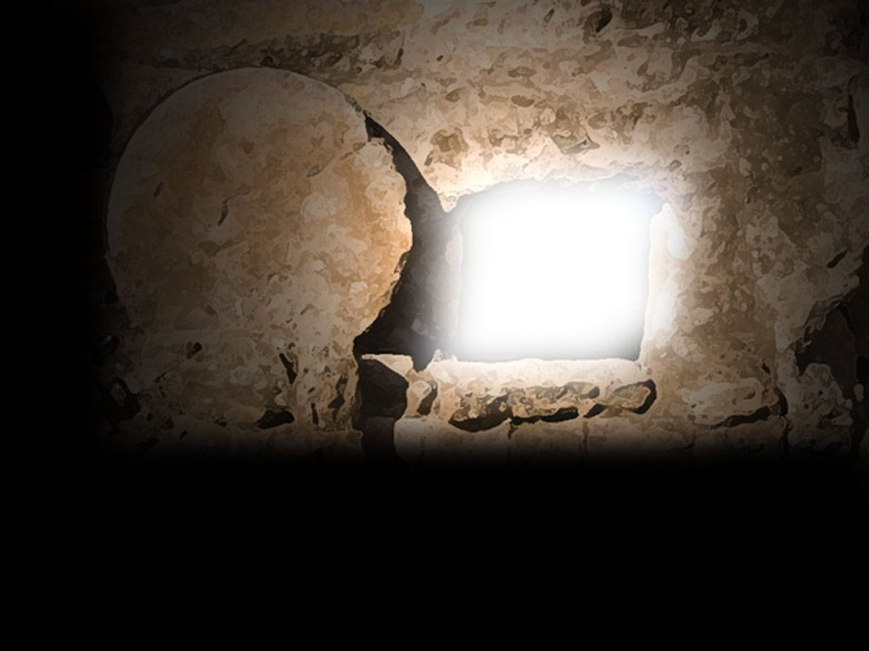
See! What a morning! Luke 24:1-12

Slide 2
See! What a morning! Luke 24:1-12
“If Christ has not been raised, your faith is futile; you are still in your sins” (1 Cor. 15:17).

Slide 3
See! What a morning! Luke 24:1-12
“If Christ has not been raised, your faith is futile; you are still in your sins” (1 Cor. 15:17).
Faith based on fact, not feelings!

Slide 4
See! What a morning! Luke 24:1-12
“If Christ has not been raised, your faith is futile; you are still in your sins” (1 Cor. 15:17).
Faith based on fact, not feelings!
Resurrection Day

Slide 5
See! What a morning! Luke 24:1-12
“If Christ has not been raised, your faith is futile; you are still in your sins” (1 Cor. 15:17).
Faith based on fact, not feelings!
Resurrection Day
Moved stone

Slide 6
See! What a morning! Luke 24:1-12
“If Christ has not been raised, your faith is futile; you are still in your sins” (1 Cor. 15:17).
Faith based on fact, not feelings!
Resurrection Day
Moved stone
Empty tomb

Slide 7
See! What a morning! Luke 24:1-12
“If Christ has not been raised, your faith is futile; you are still in your sins” (1 Cor. 15:17).
Faith based on fact, not feelings!
Resurrection Day
Moved stone
Empty tomb
Angel’s testimony

Slide 8
See! What a morning! Luke 24:1-12
“If Christ has not been raised, your faith is futile; you are still in your sins” (1 Cor. 15:17).
Faith based on fact, not feelings!
Resurrection Day
Moved stone
Empty tomb
Angel’s testimony
Jesus’ predictions

Slide 9
See! What a morning! Luke 24:1-12
“If Christ has not been raised, your faith is futile; you are still in your sins” (1 Cor. 15:17).
Faith based on fact, not feelings!
Resurrection Day
Moved stone
Empty tomb
Angel’s testimony
Jesus’ predictions
Women’s testimony

Slide 10
See! What a morning! Luke 24:1-12
“If Christ has not been raised, your faith is futile; you are still in your sins” (1 Cor. 15:17).
Faith based on fact, not feelings!
Resurrection Day
Moved stone
Empty tomb
Angel’s testimony
Jesus’ predictions
Women’s testimony
Doubting disciples

Slide 11
See! What a morning! Luke 24:1-12
“If Christ has not been raised, your faith is futile; you are still in your sins” (1 Cor. 15:17).
Faith based on fact, not feelings!
Resurrection Day
Moved stone
Empty tomb
Angel’s testimony
Jesus’ predictions
Women’s testimony
Doubting disciples
Linen graveclothes

Slide 12
See! What a morning! Luke 24:1-12
“If Christ has not been raised, your faith is futile; you are still in your sins” (1 Cor. 15:17).
Faith based on fact, not feelings!
The need for faith in the risen Christ

Slide 13
See! What a morning! Luke 24:1-12
“If Christ has not been raised, your faith is futile; you are still in your sins” (1 Cor. 15:17).
Faith based on fact, not feelings!
The need for faith in the risen Christ
Faith based on fact not understanding

Slide 14
See! What a morning! Luke 24:1-12
“If Christ has not been raised, your faith is futile; you are still in your sins” (1 Cor. 15:17).
Faith based on fact, not feelings!
The need for faith in the risen Christ
Faith based on fact not understanding
Need for a “step of faith”

Slide 15
See! What a morning! Luke 24:1-12
“If Christ has not been raised, your faith is futile; you are still in your sins” (1 Cor. 15:17).
Faith based on fact, not feelings!
The need for faith in the risen Christ
Faith based on fact not understanding
Need for a “step of faith”
Faith in stages

Slide 16
See! What a morning! Luke 24:1-12
“If Christ has not been raised, your faith is futile; you are still in your sins” (1 Cor. 15:17).
Faith based on fact, not feelings!
The need for faith in the risen Christ
Faith based on fact not understanding
Need for a “step of faith”
Faith in stages
Application:

Slide 17
See! What a morning! Luke 24:1-12
“If Christ has not been raised, your faith is futile; you are still in your sins” (1 Cor. 15:17).
Faith based on fact, not feelings!
The need for faith in the risen Christ
Faith based on fact not understanding
Need for a “step of faith”
Faith in stages
Application:
Faith in Jesus

Slide 18
See! What a morning! Luke 24:1-12
“If Christ has not been raised, your faith is futile; you are still in your sins” (1 Cor. 15:17).
Faith based on fact, not feelings!
The need for faith in the risen Christ
Faith based on fact not understanding
Need for a “step of faith”
Faith in stages
Application:
Faith in Jesus
Spiritual check-up

